Slide 1

SIW fed-Metamaterial loaded MIMO antenna with
enhanced gain and isolation for 5G mmWave applications
Presented By : Adarsh Kr. Singh (BTECH/10094/22)
Abhiraj Mitra (BTECH/10061/22)
Guide: Dr. S Pal
Birla Institute of Technology, Mesra | Department of Electronics and Communication Engineering

Slide 2
OVERVIEW
Introduction
Challenges
Literary Review
Methodology
Progress
Results
Possible Improvements/ Further Steps
References
Birla Institute of Technology, Mesra | Department of Electronics and Communication Engineering

Slide 3
INTRODUCTION
The demand for high-performance antennas in 5G millimeter-wave (MMW) communication is rapidly increasing, requiring designs that offer wide bandwidth, high gain, low mutual coupling, and beam-steering capabilities. This project focuses on developing a multiple-input multiple-output (MIMO) antenna system tailored for 28 GHz applications.
The proposed design incorporates a bow-tie antenna fed by a substrate-integrated waveguide (SIW) to ensure efficient radiation. To enhance gain, metamaterial (MM)-based structures are integrated, leveraging their unique electromagnetic properties. Additionally, a modified square resonator (MSR) is introduced between MIMO elements to improve isolation and enable beam tilting. The system is currently being evaluated through simulations and experimental validation to ensure its effectiveness in real-world applications.
Birla Institute of Technology, Mesra | Department of Electronics and Communication Engineering

Slide 4
CHALLENGES
First challenge
Metamaterial (MM) Structure Complexity: Integrating MM for gain enhancement and a resonator for isolation requires careful geometric tuning to ensure effectiveness at 28 GHz.
In the early stages of designing and optimizing the proposed MIMO antenna system, several challenges can arise that may slow down progress and impact performance. The two main concerns are as follows-
Second challenge
Mutual Coupling and Isolation: The proximity of radiating elements could lead to unwanted electromagnetic interactions, limiting isolation improvement.
Birla Institute of Technology, Mesra | Department of Electronics and Communication Engineering

Slide 5
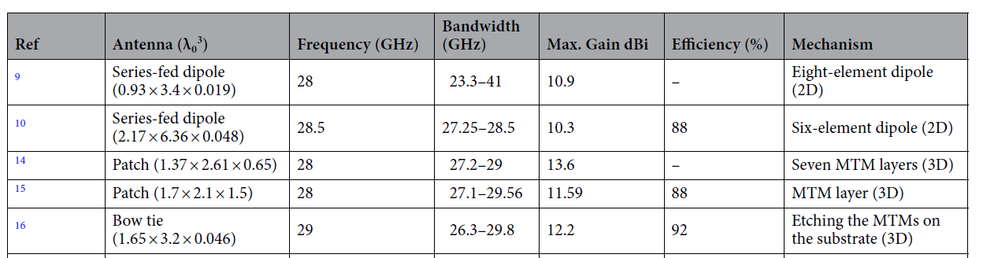
LITERARY REVIEW
1.
2.
3.
4.
5.
Birla Institute of Technology, Mesra | Department of Electronics and Communication Engineering

Slide 6
METHODOLOGY
gain enhancement of the bow-tie antenna by MM cells
cascading of two optimized bow-tie antennas
bow-tie antenna fed by SIW at 28GHz
fabrication and measurement of antenna parameters
employing modified resonator structures for isolation and beam tilting
Birla Institute of Technology, Mesra | Department of Electronics and Communication Engineering

Slide 7
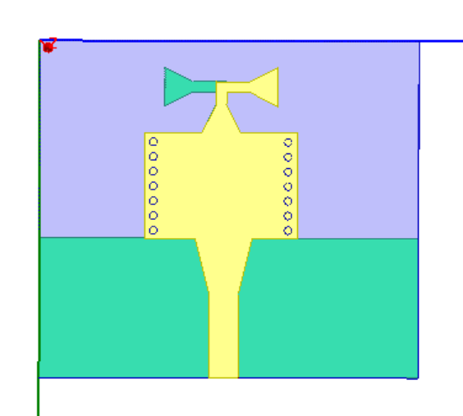


PROGRESS
SPECIFICATIONS
Substrate used = Rogerts RT/ duroid 5880
Dimension of the antenna = 16mm x 18mm
Diameter of the via = 0.36mm
FRONT
BACK
Birla Institute of Technology, Mesra | Department of Electronics and Communication Engineering

Slide 8
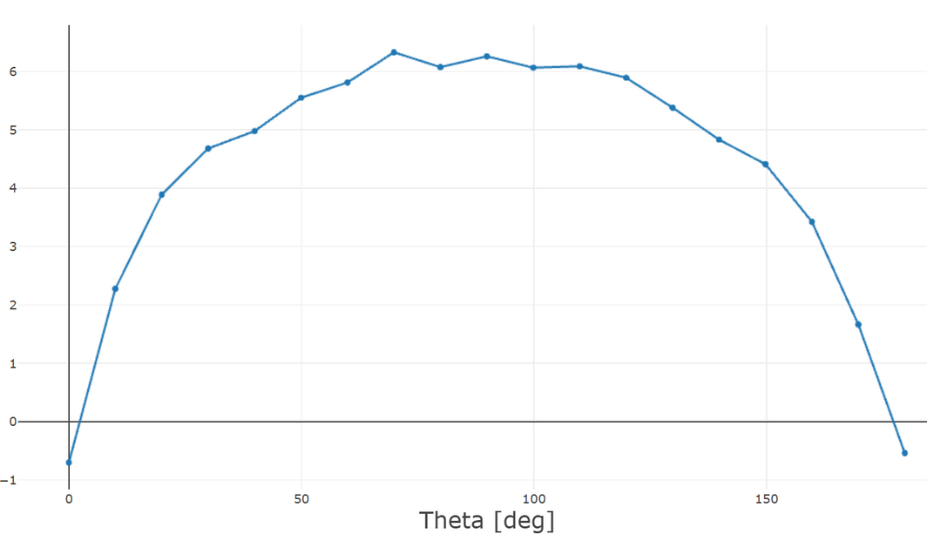
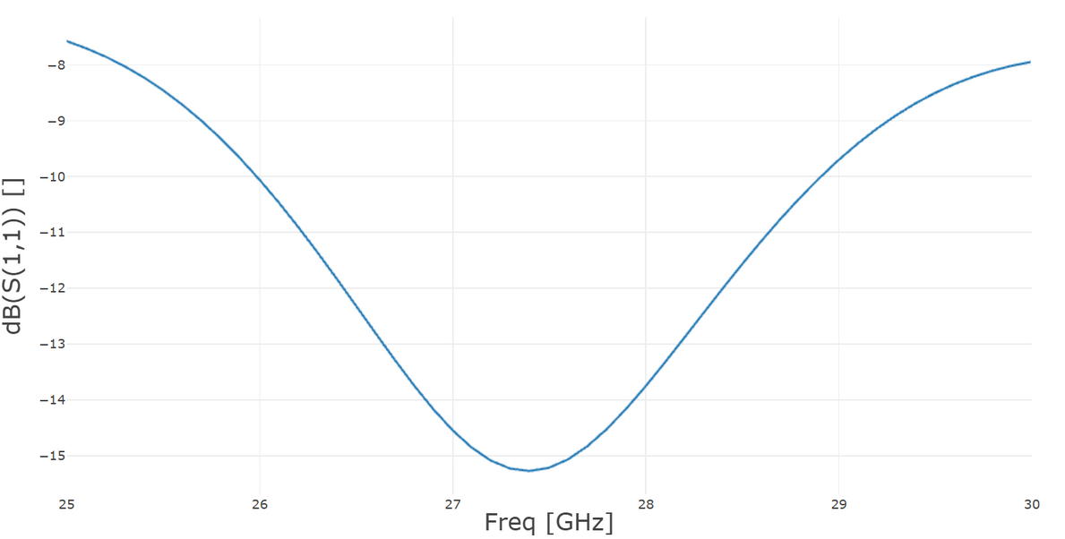


RESULTS
-10db bandwidth of 3GHz
Peak Gain of +6.3db at 28GHz
Reflection Coefficient
Realized Gain
Birla Institute of Technology, Mesra | Department of Electronics and Communication Engineering

Slide 9
Possible Improvements :
To achieve a more optimized resonance at 28 GHz with a symmetrical S11 curve, slight modifications can be made to the antenna structure. Adjusting the bow-tie radiator dimensions parameters, and optimizing the substrate-integrated waveguide (SIW) feed can effectively shift the frequency response. Further refinements in ground plane design and matching network will enhance impedance matching and bandwidth performance.
Next Stage:
The next phase of development focuses on integrating metamaterial (MM) unit cells into the antenna substrate to enhance gain. These MM structures are designed to manipulate electromagnetic wave propagation, providing zero-index refraction ,the antenna’s directivity and overall performance can be significantly enhanced. Simulation-based tuning will ensure the MM integration achieves the desired gain improvement without compromising bandwidth or isolation.
Birla Institute of Technology, Mesra | Department of Electronics and Communication Engineering

Slide 10
REFERENCES
Wang, H., Kedze, K. E. & Park, I. A high-gain and wideband series-fed angled printed dipole array antenna. IEEE Trans. Antennas
Propag. 68(7), 5708–5713 (2020).
2. Maurya, N. K., Ammann, M. J. & Mcevoy, P. Series-fed omnidirectional mm-wave dipole array. IEEE Trans. Antennas Propag.
71(2), 1330–1336 (2023).
3. Wani, Z., Abegaonkar, M. P. & Koul, S. K. High-low-epsilon biaxial anisotropic lens for enhanced gain and aperture efficiency of
a linearly polarized antenna. IEEE Trans. Antennas Propag. 68(12), 8133–8138 (2020).
4. Jeong, M. et al. Performance improvement of microstrip patch antenna using a novel double-layer concentric rings metaplate for
5G millimeter wave applications. Int. J. RF Microw. Comput.-Aided Eng. 31(2), e22509 (2021).
5. Esmail, B. A. F. & Koziel, S. Design and optimization of metamaterial-based 5G millimeter wave antenna for gain enhancement.
IEEE Trans. Circuits Syst.
Birla Institute of Technology, Mesra | Department of Electronics and Communication Engineering

Slide 11
THANK YOU
Birla Institute of Technology, Mesra | Department of Electronics and Communication Engineering

